Slide 1
Model for Predicting Contact Lenses
Classification using KNN (K-Nearest Neighbour) Algorithm
S M Asif Al - Samy (26590)

Slide 2
Objective
Using Lenses Data Set build a model to predict contact lenses which will be well fitted for a patient
For obtaining this classification KNN (K-Nearest Neighbours) supervised algorithm is used.
Compare the results (accuracy) between R and Python.

Slide 3
About Data Set
Class Values:
the patient should be fitted with hard contact lenses,
the patient should be fitted with soft contact lenses,
the patient should not be fitted with contact lenses.
Attributes:
age of the patient: (1) young, (2) pre-presbyopic, (3) presbyopic
spectacle prescription: (1) myope, (2) hypermetrope
astigmatic: (1) no, (2) yes
tear production rate: (1) reduced, (2) normal

Slide 4
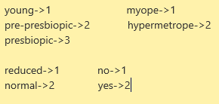
Changes in Data Set
Class Values:
Hard, Soft, None
Attributes:
Age: (1) 1, (2) 2, (3) 3
SpectaclePrescrip: (1) 1, (2) 2
Astigmatic: (1) 1, (2) 2
TearProdRate: (1) 1, (2) 2
https://archive.ics.uci.edu/ml/datasets/lenses

Slide 5
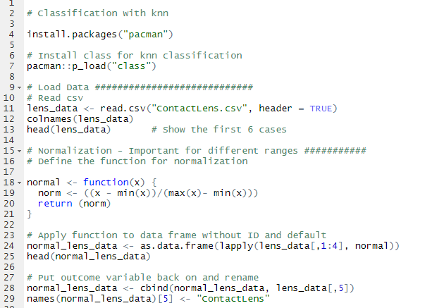
Implementation using R

Slide 6
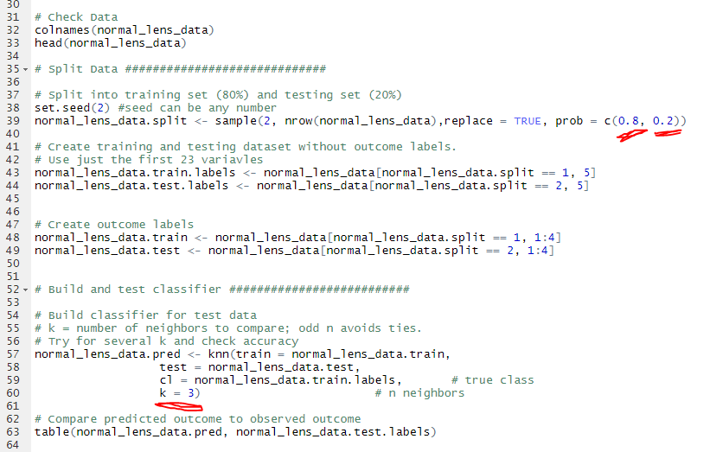
Implementation using R

Slide 7

Output
Total trained: 18 data (80%)
Total tested: 6 data (20%)
Accuracy: 83.33%

Slide 8
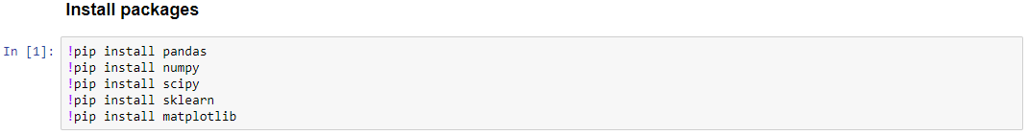
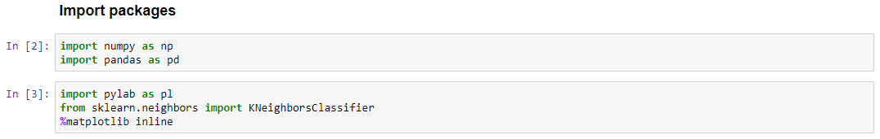
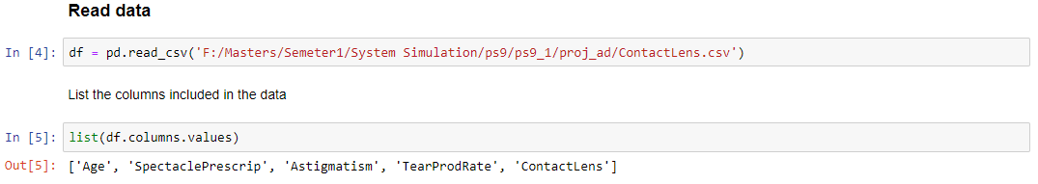
Implementation using Python

Slide 9
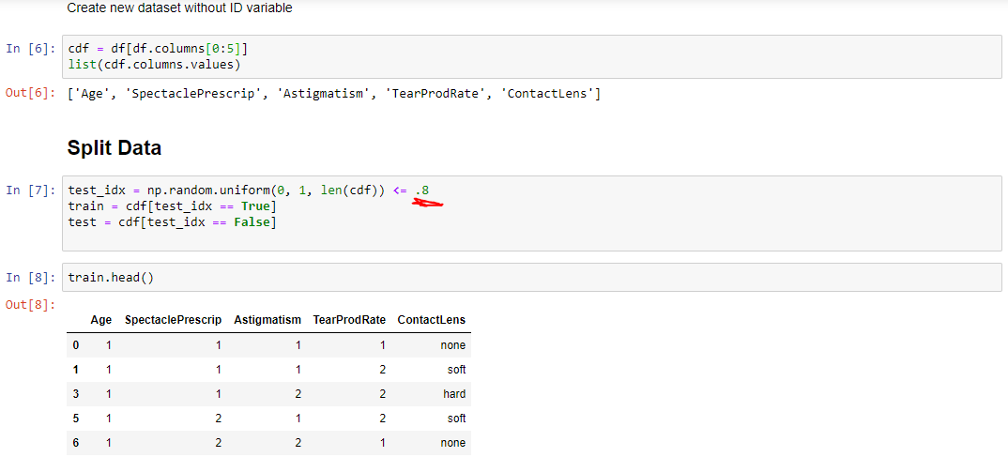
Implementation using Python

Slide 10
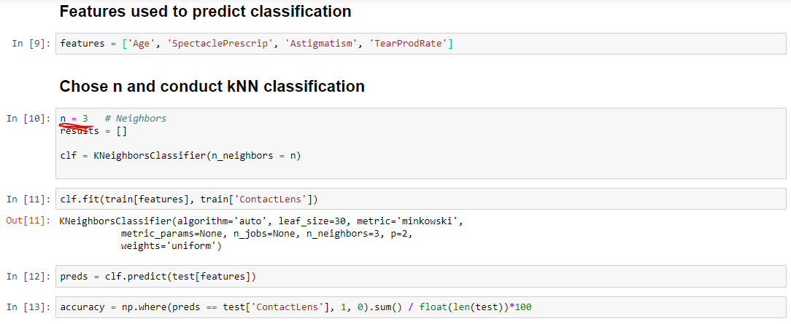
Implementation using Python

Slide 11
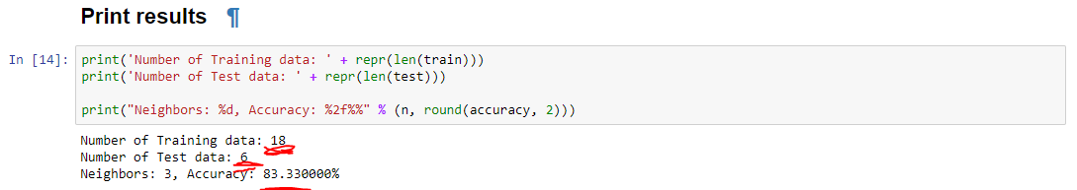
Output

Slide 12
Pros and Cons of KNN
Advantages:
K-NN is pretty intuitive and simple
Effective if the training data is large
Very easy to implement for multi-class problem
Disadvantages:
K-NN slow algorithm
Imbalanced data causes problems
Optimal number of neighbors

Slide 13


Slide 14


